Slide 1
Fraud Prevention & Detection Technologies
CYS339

Slide 2
DATA ANALYIS
UNIT 1

Slide 3
data analysis
Data are facts and statistics collected together for reference or analysis.
Analysis is a detailed examination of the elements or structure of something.
Data analysis is the process of examining raw data to draw conclusions about the information it contains, often using statistical techniques, to understand patterns, trends, and relationships.

Slide 4
Fraud
Fraud refers to the deliberate use of deception, dishonesty, or false representation to gain an unfair advantage, often resulting in financial or personal loss to the victim.
In the context of cybersecurity, fraud typically involves unauthorized access to systems, data theft, or manipulation of information for malicious purposes.
Examples include identity theft, phishing, credit card fraud, and insider threats.

Slide 5
Detection technologies
Detection technologies are tools, systems, or methodologies used to identify and respond to malicious activities, anomalies, or threats within a network or system.
These technologies are designed to monitor, analyze, and flag suspicious behavior, enabling organizations to mitigate risks and prevent cyber attacks.
Examples include Intrusion Detection Systems (IDS), firewalls, machine learning algorithms, and anomaly detection systems.

Slide 6
Three Reasons Data Analysis is Must
Improved Efficiency in Detecting and Preventing Cyber Threats
Data analysis enhances the efficiency of cybersecurity operations by automating the detection of anomalies and potential threats.
Advanced analytical tools, such as Intrusion Detection Systems (IDS) and Security Information and Event Management (SIEM) systems, process vast amounts of data in real-time to identify suspicious behavior.
This allows cybersecurity teams to respond quickly and effectively, minimizing downtime and preventing breaches

Slide 7
Three Reasons Data Analysis is Must (Continues…)
Enhanced Understanding of Attack Patterns and Vulnerabilities
Data analysis helps cybersecurity professionals gain deeper insights into attack patterns, tactics, and techniques used by malicious actors.
By analyzing historical attack data and threat intelligence, organizations can identify vulnerabilities in their systems and develop strategies to strengthen their defenses.
This proactive approach reduces the likelihood of successful cyberattacks and improves overall security posture.

Slide 8
Three Reasons Data Analysis is Must (Continues…)
Informed Decision-Making for Threat Response
Data analysis is critical in cybersecurity for making informed decisions about how to respond to threats and vulnerabilities.
By analyzing data from logs, network traffic, and security incidents, cybersecurity professionals can identify patterns of malicious activity, assess risks, and prioritize responses.
This enables organizations to take proactive measures to mitigate threats and reduce the impact of cyberattacks.

Slide 9
Data Analysis in Auditing
A cybersecurity audit is a process that includes the analysis of a company's IT infrastructure for review and improvement.
Purpose
Data analysis in auditing is primarily used to assess the accuracy, completeness, and reliability of financial records and transactions.
Scope
Focuses on evaluating internal controls, compliance with regulations, and the overall financial health of an organization.

Slide 10
Data Analysis in Auditing (Continues…)
Tools and Techniques
Uses tools like Computer-Assisted Audit Techniques (CAATs) and software such as ACL or IDEA.
Techniques include trend analysis, ratio analysis, and variance analysis.
Outcome
Provides assurance to stakeholders (e.g., shareholders, regulators) that financial statements are free from material misstatements.

Slide 11
Data Analysis in Investigation
Investigation is the act or process of examining a crime, problem, statement, etc.
Purpose
Data analysis in investigations is used to uncover evidence of fraud, misconduct, or illegal activities.
It aims to identify the root cause of issues and determine accountability.
Scope
Focuses on specific incidents or allegations, often requiring a deep dive into detailed transactional data.
Involves examining all relevant data rather than relying on sampling.

Slide 12
Data Analysis in Investigation (Continues…)
Tools and Techniques
Uses forensic data analysis tools like EnCase, FTK, or Tableau for visualization.
Techniques include link analysis, pattern recognition, and anomaly detection.
Outcome
Provides actionable evidence for legal proceedings, disciplinary actions, or recovery of losses.

Slide 13
Key differences between Auditing and Investigation
Objective
Auditing focuses on providing assurance and compliance.
Investigation focuses on uncovering wrongdoing and gathering evidence.
Approach
Auditing is systematic and often follows a predefined plan.
Investigation is reactive and driven by specific allegations or incidents.

Slide 14
Key differences between Auditing and Investigation (Continues…)
Data Depth
Auditing typically uses sampling and high-level analysis.
Investigation requires exhaustive examination of detailed data.
Outcome Use
Auditing results are used for stakeholder assurance and regulatory compliance.
Investigation results are used for legal or disciplinary actions.

Slide 15
What can Data Analysis do?
Identify Patterns and Trends in Cyber Threats
Support Decision-Making for Incident Response
Improve Efficiency in Threat Detection
Detect Anomalies and Potential Breaches
Enhance Threat Intelligence and Proactive Defense

Slide 16
What Data Analysis Cannot Do in Cybersecurity
Replace Human Judgment in Incident Response
A system may flag a legitimate user’s unusual activity as suspicious, requiring human intervention to verify the alert.
Guarantee Accuracy in Threat Detection
False positives and false negatives can occur if an Intrusion Detection System (IDS) is not well configured.

Slide 17
COMMON ANALYSIS PROCEDURES & FUNCTIONS
UNIT 2

Slide 18
COMMON ANALYSIS PROCEDURES
Financial Ratio, Variance, Percentage, Aging & Average

Slide 19
Financial Ratio
Ratio is the quantitative relation between two amounts showing the number of times one value contains or is contained within the other.
A ratio compares values e.g., 3 to 1 (3:1).
Financial ratios are created with the use of numerical values taken from financial statements to gain meaningful information about a company.

Slide 20
Financial Ratio (Continues…)
These ratios help stakeholders (investors, creditors, management) assess:
Liquidity (ability to meet short-term obligations)
Profitability (ability to generate earnings)
Leverage (degree of debt reliance)
Efficiency (effectiveness in asset utilization)
In Cybersecurity it helps the CISO to make the above analysis.

Slide 21
Financial Ratio (Continues…)
Advantages of using Financial Ratio
Simplifies Complex Data - Ratios condense large datasets into comparable metrics, making trends easier to identify.
Cost-Benefit Analysis - Helps quantify the financial impact of security investments.
Prioritization – Identifies high-risk areas by correlating security incidents with financial losses.

Slide 22
Financial Ratio (Continues…)
Limitations of Financial Ratio
Oversimplification – May ignore qualitative factors (e.g., employee awareness, emerging threats).
Data Accuracy Issues
Lagging Indicators - Many ratios reflect past performance rather than predicting future threats.

Slide 23
Financial Ratio (Continues…)
Question
A company spends $50,000 annually on cyber security measures. The total financial loss due to cyber attacks before implementing the measures was $200,000 and after implementation the loss reduced to $80,000 Dollars.
Calculate the Return on Investment.
ROI = (Total Benefit - Cost of Investment) / Cost of Investment * 100%
= [(200000 – 80000) - 50000/ 50000] * 100%
= [(120000 – 50000)/ 50000] * 100%
= (70000 / 50000) * 100%
= 1.4 * 100%
= 140%
This means that for every dollar spent on cybersecurity, the company gained $1.40 in reduced financial losses.

Slide 24
Variance
Variance measures the differences between expected and actual value to identify deviations.
Deviation is a measure which is used to find the difference between the observed value and the expected value of a variable.
It can be applied in;
Financial Auditing
Cybersecurity

Slide 25
Variance (Continues…)
Types of Variance
Favourable Variance – Actual < Expected (e.g., lower costs)
Unfavourable Variance – Actual > Expected (e.g., higher breach costs)
Variance = Actual − Expected

Slide 26
Variance (Continues…)
Question
A company records an expected daily login count of 5000 for each employee. On a particular day, the actual recorded log in count was 7500.
Calculate the variance.
Determine whether it's favorable or unfavorable.
Variance = Actual – Expected
= 7500 – 5000
= 2500
Favorable Variance = Actual < Expected
Unfavorable Varia.. = Actual > Expected
Therefore, the Variance is Unfavorable.
NOTE: + Variance is Unfavorable
– Variance is Favorable

Slide 27
Variance (Continues…)
Advantages of using Variance
Anomaly Detection – Helps identify deviations from normal behavior (e.g., unusual network traffic, login attempts).
Supports Trend Analysis – Reveals changes over time (e.g., increasing attack frequency).
Useful in Statistical Models – Key in machine learning and predictive analytics for cybersecurity (e.g., outlier detection).

Slide 28
Variance (Continues…)
Limitations of using Variance
Sensitive to Outliers – Leading to false positives in threat detection.
May Miss Subtle Attacks - Low variance attacks (e.g., slow, persistent threats) can evade detection.

Slide 29
Percentage
In mathematics, a percentage is a number or ratio expressed as a fraction of 100.
It is often denoted using the percent sign (%).
It is also applied in;
Financial Analysis
Cybersecurity

Slide 30
Percentage (Continues…)
Common Percentage Formulas
Percentage of Total
Percentage = (Part / Whole) * 100%
Percentage Change
Percentage Change = [(New – Old) / Old] * 100%

Slide 31
Percentage (Continues…)
Question
A cybersecurity team analyzes 500 phishing attempts in a month. Out of these, 35 where successful.
Calculate the attack success rate percentage.
Percentage of Total = (Part / Whole) * 100%
= (35 / 500) * 100%
= 7%
Therefore, the attack success rate was 7%

Slide 32
Percentage (Continues…)
Advantages of Percentages
Simplifies Interpretation
Trend Identification – Helps track changes over time (e.g., "Phishing attempts increased by 15% this quarter").
Normalizes Data – Allows comparison across different scales.

Slide 33
Percentage (Continues…)
Limitations of using Percentages
Limited in Isolation – Percentages alone don’t explain causality or risk impact (requires additional metrics).
Potential for Misleading Context – Without proper reference points, percentages can be misinterpreted (e.g., "50% of attacks" without knowing total volume).
Can Mask Absolute Values – A small percentage change may represent a critical threat if the base number is large (e.g., "1% increase in breaches" could mean thousands of incidents).

Slide 34
Aging
Aging analysis examines the time elapsed since an event occurred to detect anomalies that may indicate fraud.
It can be applied in Cybersecurity for;
Time-Based Segmentation – Groups data by age (e.g., inactive accounts suddenly accessed after 6+ months)
Thresholds & Rules – Flags unusual delays (e.g., late invoice submissions)
Trend Analysis – Detects abnormal aging patterns (e.g., old credentials reused in a brute-force attack)

Slide 35
Aging (continues…)
Question
A company tracks unpatched vulnerabilities overtime. The data is as follows:
What percentage of vulnerabilities are odder than 60 days?
Percentage of Total = (Part / Whole) * 100%
= [(10 + 5) / (25 + 20 + 10 + 5)] * 100%
= (15 / 60) * 100%
= 0.25 * 100%
= 25%
Age (Days) | Unpatched Vulnerabilities
0 – 30 | 25
31 – 60 | 20
61 – 90 | 10
91+ | 5

Slide 36
Aging (continues…)
Advantages
Limitations
Simple & Scalable
Detects Timing Anomalies
False Positives
Static Thresholds – Requires manual updates to adapt to new fraud tactics.

Slide 37
Average (Mean) Analysis
Average measures central tendency to identify typical values.
It is applied in;
Finance
Cybersecurity
Formula is;
Average = ∑ Values / Count​

Slide 38
Average (Mean) Analysis (Continues…)
Question
A security operations center measures the mean time to detect cyber threats over 5 incidents. Detection Times (hours) : [4,5,3, 6,7]
Calculate the mean time
Average = ∑ Values / Count
= (4 + 5 + 3 + 6 + 7) / 5
= 25 / 5
= 5
Therefore, the mean time to detect the Cyberthreats is 5 hours.

Slide 39
Average (Mean) Analysis (Continues…)
Advantages
Limitations
Simple & Fast – Easy to compute and interpret.
Baseline Comparison – Helps distinguish normal vs. suspicious behavior.
False Positives/Negatives
Static Baseline Issue – Requires updates to reflect evolving behavior.

Slide 40
Common Analysis Functions
Filter, sort, join, append, pivot, trend, regression, ratio, vlookup, index/match, xlookup, hlookup, eyelookup, grouping, summarization, and stratification

Slide 41
FILTER
Filtering refers to removing unwanted material.
The FILTER function in Excel is used to return specific data from a range based on one or more conditions.
It helps extract relevant data dynamically without manually sorting or searching.
It can be applied in Cybersecurity to;
Identifying Malicious IPs Quickly
Tracking Phishing Attacks

Slide 42
FILTER (Continues…)
Syntax of The FILTER Function
=FILTER(array, include, [if_empty])
array → The range of data you want to filter.
include → The condition(s) used to filter the data.
if_empty (optional) → The value to return if no data matches the condition.

Slide 43
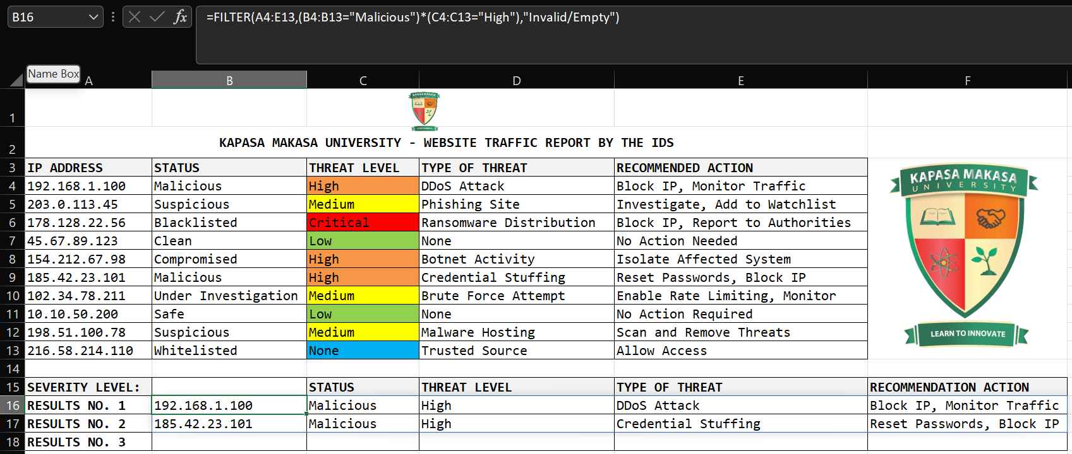
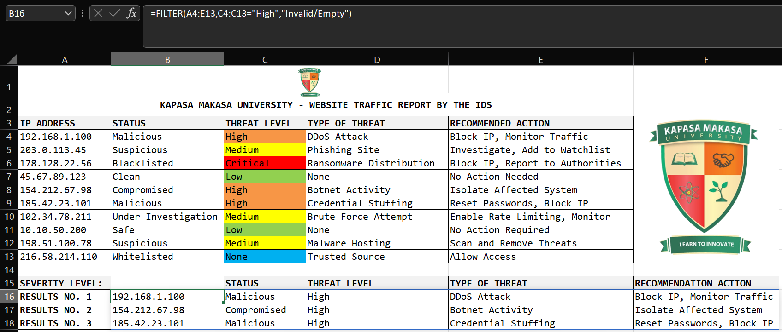
FILTER (Continues…)
Single Condition
Multiple Conditions
=FILTER(A4:E13,C4:C13="High", “Invalid/Empty")
This will return only rows where Threat Level (column C) is "High“.
=FILTER(A4:E13, (B4:B13="Malicious") * (C4:C13="High"), "Invalid/Empty")
The * acts as AND logic, meaning both conditions must be met.

Slide 44
FILTER (Continues…)
Filter Data Dynamically
=FILTER(A4:E13,C4:C13=B15,“Invalid/Empty")
This will update results automatically as the value in B15 changes.

Slide 45
FILTER (Continues…)
Advantages
Limitations
Reduced Noise – Eliminates irrelevant data.
Faster Processing – Decreases data volume.
Risk of Over-Filtering
Potential Data Loss

Slide 46
Sort
Organize data in meaningful order.
Arranges data in ascending or descending order.
The SORT Function syntax in Excel is;
=SORT(array,[sort_index],[sort_order],[by_col])
=SORTBY(array, by_array1, [sort_order1], [by_array2, sort_order2],…)

Slide 47
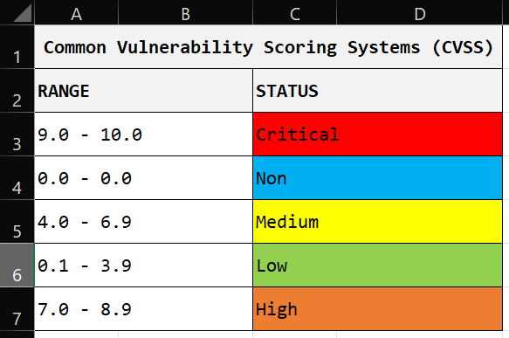
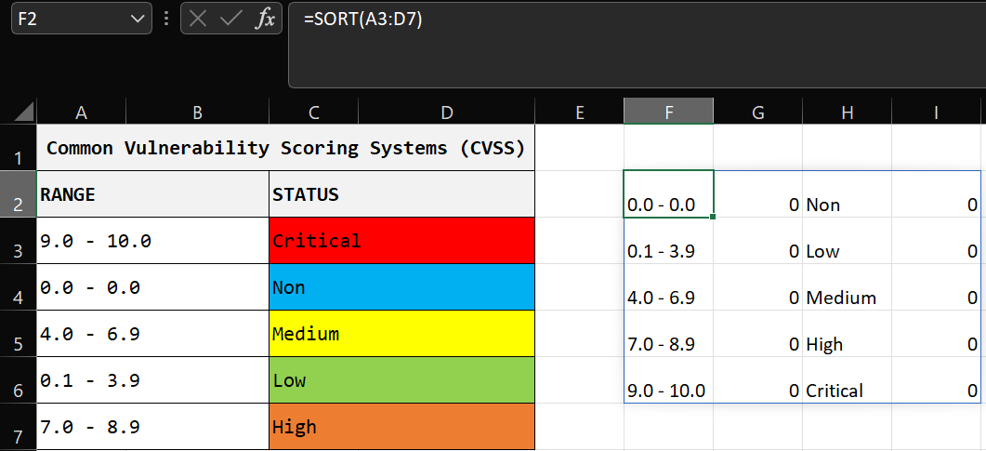
Sort (CONTINUES…)

Slide 48
Sort (CONTINUES…)
Advantages
Limitations
Prioritization of Threats – Sorts data by severity (e.g., high-risk alerts first), enabling faster response to critical incidents.
Context Loss – Sorting by one column may hide relationships in other fields.
Misleading Order – Ascending/descending sorts may unintentionally emphasize less relevant data.

Slide 49
Join
Join combines related data from different sources (tables or databases).
Combining is usually based on a common key (in databases we use a PRIMARY KEY and FOREIGN KEY).
Common types of joins include:
Inner join
Right join
Full outer join
Left join
In Excel the syntax for TEXTJOIN Function is;
=TEXTJOIN(delimiter, ignore_empty, text1, [text2], …)

Slide 50
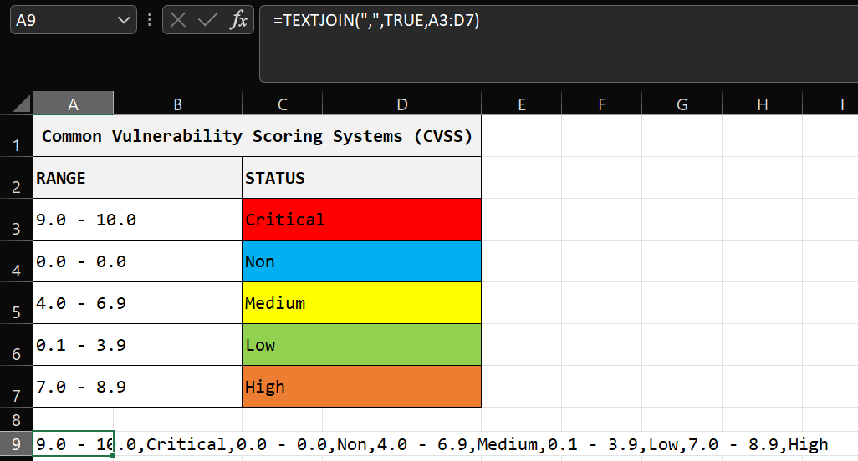
Join (CONTNUES…)

Slide 51
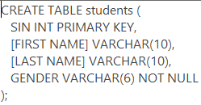
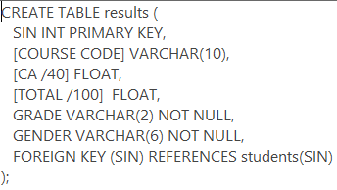




Join (CONTNUES…)
Bellow is how to use INNER JOIN in a relational database.

Slide 52
Join (Continues…)
Advantages
Enhanced Correlation – Combines data from multiple sources (e.g., firewall logs + authentication events) to detect complex attack patterns.
Comprehensive Threat Detection – Links related events (e.g., matching IPs in network logs with known threat intelligence feeds).

Slide 53
Join (Continues…)
Limitations
False Positives/Negatives
Complexity
Privacy Risks

Slide 54


APPEND
Append involves adding new rows of data to an existing database.
Usually when both have the same structure.

Slide 55
APPEND (Continues…)
Advantages
Data Aggregation – Combines multiple datasets.
Simplified Historical Analysis - Enables trend detection by appending new data to historical records (e.g., tracking attack patterns over months).
Compatibility with SIEMs – Many security tools (e.g., Splunk, ELK) rely on appended logs for correlation and alerting.

Slide 56
APPEND (Continues…)
Limitations
Data Duplication
Increased Storage Costs
Performance Overhead

Slide 57
Join & Append
Question
Join and append are two (2) prevalent data analysis functions. Highlight the key similarities and differences between these two functions.

Slide 58
Join & Append (Continues…)
Similarities | Differences
Both are used to combine data. | Join combines two tables using a common column while append adds new rows to an existing table.
Both work with tables (or lists).
Both help organize and analyze data.

Slide 59
Pivot
Pivot summarize and cross-tabulate data.
Transforms data by rearranging rows and columns to summarize key information.
The GETPIVOTDATA function is used to extract specific data from a PivotTable dynamically.
GETPIVOTDATA(data_field, pivot_table, [field1, item1, field2, item2, ...])

Slide 60
Pivot (Continues…)
data_field – The name of the field you want to retrieve (in quotes).
pivot_table – A cell reference to any part of the PivotTable.
field1, item1, etc. – Optional pairs that specify which field and value to filter by.
For example;
=GETPIVOTDATA("Total Sales", A1, "Salesperson", "Alice")

Slide 61
Pivot (Continues…)

Slide 62
Pivot (Continues…)
Advantages
Limitations
Enhanced Data Summarization
Quick Pattern Recognition
Over-Simplification Risk
Static Output – Requires manual updates if source data changes, unlike real-time analytics.

Slide 63
Trend
Trend helps to identify patterns over time.
Helps in forecasting and decision making.
The TREND function in Excel predicts future values based on existing data using linear regression.
=TREND(known_y's, [known_x's], [new_x's], [const])

Slide 64
Trend (Continues…)
known_y's – The dependent values (the values you want to predict from).
known_x's (optional) – The independent values (the existing input data).
new_x's (optional) – The values for which you want to predict new y values.
const (optional, default = TRUE) – If TRUE, the equation includes an intercept; if FALSE, the regression line passes through zero.

Slide 65
Trend (Continues…)
Advantages
Limitations
Anomaly Detection
Helps predict future attacks by analyzing historical trends
False Positives/Negatives
Historical Bias
Requires large datasets for accuracy
Time Lag – Trends reflect past events

Slide 66
Regression
Regression model relationships between variables.
Common types:
Linear regression
Logistic regression.

Slide 67
Regression (Continues…)
ADVANTAGES
LIMITATIONS
Predictive Capability – Forecasts future threats.
Anomaly Detection – Identifies outliers.
Root Cause Analysis
Automation Potential – Integrates with AI/ML for real-time threat scoring.
Lagging Indicators
Data Quality Dependence

Slide 68
Regression (Continues…)
Question
A companies revenue depends on the amount spent on advertising, the relationship between sales and the advertising spent is modeled by the following regression equation.
Sales = $500 + (10 * Advertising)
If a company spends $2000 on advertising, predict the expected sales revenue.
Sales = $500 + (10 * Advertising)
= $500 + (10 * $2000)
= $500 + $20000
= $20500

Slide 69
VLOOKUP
Vertical Lookup is an excel function.
It is used to search for a specific value in a column and return a corresponding value from another column in the same row.
Key Characteristics of VLOOKUP –
Searches vertically (top to bottom) in the first column of a table.
Can perform exact (FALSE) or approximate (TRUE) matches.

Slide 70
VLOOKUP (continues…)
basic syntax –
=VLOOKUP(lookup_value, table_array, col_index_num, [range_lookup])
lookup_value – the value you want to search for.
table_array – the range of cells containing the data.
col_index_num – the column number from which to retrieve the value.
range_lookup – default is TRUE (1) used for an approximate vale and FALSE (0) for an exact match.

Slide 71
VLOOKUP (continues…)
Limitations of VLOOKUP
Alternatives to VLOOKUP
Left-to-Right Lookup Only
Exact Match Requirement
Slower with Large Datasets
INDEX-MATCH
XLOOKUP
HLOOKUP

Slide 72
Grouping
Grouping is the process of organizing data into categories or clusters based on shared characteristics.
It enables analysts to:
Identify patterns and trends
Simplify complex datasets
Perform aggregate calculations
Compare subsets of data

Slide 73
Grouping (Continues…)
Key Characteristics of grouping include –
Categorization – data is divided into meaningful buckets.
Aggregation – enables summary statistics per group.
Comparative Analysis – allows group-to-group comparisons.
Dimensionality Reduction – simplifies large datasets.

Slide 74
Grouping (Continues…)
Methods of Grouping include –
Basic Grouping Techniques
Manual Categorization – Creating custom groups based on domain knowledge. For example, grouping alerts as "Malicious".
Automated Grouping – Using functions like GROUP BY (SQL) or PivotTables (Excel).

Slide 75
Grouping (Continues…)
Advanced Grouping Methods
Binning – Creating ranges for continuous data (e.g., CVSS).
Clustering – Machine learning approach for finding natural groupings (e.g., clustering malware samples by behavior using algorithms like K-means clustering).

Slide 76
Grouping (Continues…)
Cybersecurity Applications of Grouping include –
Threat Intelligence Analysis
SIEM Alert Management
Vulnerability Management
Incident Investigation

Slide 77
Grouping (Continues…)
Advantages
Disadvantages
Pattern Recognition
Noise Reduction
Simplifies large datasets by categorizing data
Threat Correlation
Prioritization
May hide important outliers
Incorrect grouping can link unrelated events
Static Grouping

Slide 78
Summarization
Is the process of distilling large datasets into concise, meaningful statistics and metrics that represent key characteristics of the data.
Its purpose is to –
Reduce data complexity
Support decision-making

Slide 79
Summarization (Continues…)
Summarization Techniques
Descriptive Statistics – include count, median, mean, mode, Standard Deviation (SD) and range.
Frequency Distributions – tally of how often values occur.
Aggregate Functions – common functions include SUM(), AVG(), COUNT(), MAX(), MIN(), and PERCENTILE().

Slide 80
Summarization (Continues…)
Visualization of Summaries
Advantages
Bar Charts
Pie Charts
Simplifies Complex Data
Improves Decision-Making
Enhances Reporting

Slide 81
Stratification
Is the process of dividing a population into homogeneous subgroups (strata) based on shared characteristics.
Characteristics of stratification include –
Segmentation – creates meaningful subgroups.
Homogeneity – members within strata are similar.
Heterogeneity – strata differ significantly from each other.
Representation – maintains population proportions.

Slide 82
Stratification (Continues…)
Advantages
Disadvantages
Targeted Threat Detection
Reveals attack patterns
Organizes data according
Over-Segmentation Risk
Increased Complexity
Stratification Bias

Slide 83
DATA ANALYSIS
UNIT 3

Slide 84
TYPE OF DATA ANALYSIS
Quantitative
It involves numerical data and statistical techniques to detect, analyze, and prevent cyber threats.
It deals with data which is numerical, measurable and comparable.
Understanding the types of quantitative data analysis will use the key word (SDP)² CT which includes Statistical, Spatial, Descriptive, Diagnostic, Prescription, Predictive, Comparative and Time Series Analysis.

Slide 85
TYPE OF DATA ANALYSIS (Continues…)
Types of Quantitative Data Analysis
Descriptive Analysis
Summarizes and describes key features of security data.
Cybersecurity Application – summarizing DDoS attack durations.
Tools – SIEM dashboards, Excel and Tableau.

Slide 86
TYPE OF DATA ANALYSIS (Continues…)
Types of Quantitative Data Analysis (Continues…)
Diagnostic Analysis
Examines why security events occurred.
Cybersecurity Application – Determining root causes of breaches.
Tools – Splunk.

Slide 87
TYPE OF DATA ANALYSIS (Continues…)
Types of Quantitative Data Analysis (Continues…)
Predictive Analysis
Uses historical data to forecast future threats.
Cybersecurity Applications – Predicting attack volumes based on historical trends and Forecasting potential DDoS attack times.
Tools – Machine Learning (ML).

Slide 88
TYPE OF DATA ANALYSIS (Continues…)
Types of Quantitative Data Analysis (Continues…)
Prescriptive Analysis
Recommends actions based on data insights.
Cybersecurity Applications – automated patching prioritization and dynamic firewall rule recommendations.
Tools – SOAR platforms.

Slide 89
TYPE OF DATA ANALYSIS (Continues…)
Types of Quantitative Data Analysis (Continues…)
Comparative Analysis
Benchmarks security metrics against standards.
Cybersecurity Application – measuring security posture against industry benchmarks.
Tools – Security Scorecard.

Slide 90
TYPE OF DATA ANALYSIS (Continues…)
Types of Quantitative Data Analysis (Continues…)
Time Series Analysis
Examines security data points over time.
Cybersecurity Application – detecting seasonal attack patterns.
Tools – Elasticsearch, and Pandas.

Slide 91
TYPE OF DATA ANALYSIS (Continues…)
Types of Quantitative Data Analysis (Continues…)
Statistical Analysis
Applies mathematical models to security data.
Cybersecurity Applications – calculating probabilities of breach scenarios and performing regression analysis on attack vectors.
Tools – R and Python (NumPy and SciPy)

Slide 92
TYPE OF DATA ANALYSIS (Continues…)
Types of Quantitative Data Analysis (Continues…)
Spatial Analysis
Examines geographic patterns in threats.
Cybersecurity Application – correlating physical locations with breach attempts.
Tools – GeoIP and ArcGIS.

Slide 93
TYPE OF DATA ANALYSIS (Continues…)
Other types of Quantitative Data Analysis
Sorting
Organizing data in a structured order (e.g., chronological, severity-based) to identify trends, outliers, or critical events.
Tools – Splunk, Nessus and Qualys.
Strength – identifying high-priority threats.
Limitation - false positives.

Slide 94
TYPE OF DATA ANALYSIS (Continues…)
Other types of Quantitative Data Analysis (Continues…)
Categorization
Grouping data into predefined classes (e.g., threat types, user roles) for structured analysis.
Tools – VirusTotal and Wireshark.
Strength – simplifies reporting.
Limitation - misclassification leads to flawed policies.

Slide 95
TYPE OF DATA ANALYSIS (Continues…)
Other types of Quantitative Data Analysis (Continues…)
Relationship
Causal links between events (correlation).
Tool – Splunk.
Strength – grouping related events.
Limitation - false correlations.

Slide 96
TYPE OF DATA ANALYSIS (Continues…)
Other types of Quantitative Data Analysis (Continues…)
Profiling (Behavioural Analysis)
Establishing baselines of normal behavior to detect anomalies (e.g., unusual login times).
Tools – Cisco Stealthwatch and Splunk.
Strength – adapts to evolving threats.
Limitation - high false positives.

Slide 97
TYPE OF DATA ANALYSIS (Continues…)
Qualitative
focuses on non-numerical data (e.g., text, logs, narratives) to understand meaning, patterns, and motivations behind cyber threats.
It interprets why and how an attack occurred.
There are two major types of qualitative data analysis, which is behavioral and contextual analysis.

Slide 98
TYPE OF DATA ANALYSIS (Continues…)
Contextual
Answers “Why did this happen?”.
Tool – Splunk.
Strength – deepens understanding of attack motives.
Limitations – time-consuming and subjective bias.

Slide 99
TYPE OF DATA ANALYSIS (Continues…)
Behavioural
Answers “How did this happen?”.
Tool – Sandboxing.
Strength – detects unknown threats.
Limitations – high false positives.

Slide 100
TYPE OF DATA ANALYSIS (Continues…)
Factor | Qualitative | Quantitative
Data Type | Text, Logs and Narratives | Numbers, Metrics and Counts
Analysis Focus | Why and How? | What and How Much?
Tools | TheHive | Slunk and SIEM
Outcome | Threat Intelligence and root causes | Statistics

Slide 101
Gap Analysis
UNIT 4

Slide 102
Introduction
Gap analysis is a strategic tool used to compare the current state of a system, process, or performance with the desired or target state.
It helps identify discrepancies ("gaps") and provides insights into necessary improvements.
Gap analysis helps organisations to –
Identify vulnerabilities.
Compare existing security measures with industry standards.
Develop action plans to mitigate fraud risks.

Slide 103
Steps in Conducting Gap Analysis for
Cybersecurity Fraud Prevention
Define Objectives – Determine what fraud risks need to be addressed (e.g., identity theft).
Assess Current State (Current Cybersecurity Posture) – Review historical fraud incidents and response effectiveness.
Identify Desired State – Benchmark against industry standards (e.g., NIST guidelines).
Identify Gaps – Compare current vs. desired performance.
Develop an Action Plan – This can include new detection techniques, authentication mechanisms and awareness.

Slide 104
Using Gap Analysis in Fraud Detection
Fraud Detection Gaps – include Rule-Based Systems vs. AI/ML Models, Data Inconsistencies, and Response Delays.
Fraud Prevention Gaps – Weak Authentication and Lack of Employee Training.

Slide 105
Performing Contextual and Behavior Qualitative Analysis
UNIT 6

Slide 106
Key Concepts in Contextual and Behavioral Analysis
Keywords Analysis – involves scanning text data (emails, chats, documents) for suspicious keywords that may indicate fraud.
Content Analysis (Files, Pictures, Videos) – examines digital content for signs of manipulation or malicious intent, techniques include Metadata Analysis and Image Forensics.
Behavior Profiling – builds a baseline of normal behavior for users/systems and flags deviations.

Slide 107
Online Presence & Social Media Analysis
Social Media Investigations – it involves Identity Verification and Fraud Detection (for any form of impersonation).
Open-Source Intelligence (OSINT) – gathers publicly available data (social media, forums, news) for fraud investigations.
Deep & Dark Web Monitoring – fraudsters sell stolen data on dark web markets, monitoring helps prevent breaches.

Slide 108
Digital Forensic Process
Identification – locate relevant data (emails, logs, hard drives).
Preservation – secure data to prevent tampering (hash verification).
Analysis – examine data for fraud indicators (deleted files, hidden folders).
Reporting – document findings for legal proceedings.

Slide 109
Common Forensic Techniques
File Carving – recovers deleted files.
Memory Dump Analysis – detects malware.
Network Forensics – analyzes traffic logs for unauthorized access.
Challenges in conducting Qualitative Fraud Analysis (keyword: PEF) –
Privacy Concerns
Evolving Tactics
False Positives

Slide 110
OLAF APPROACH IN DATA ANALYSIS
UNIT 7

Slide 111
Introduction
The OLAF Approach (Object, Locate, Analyze, Follow) is a structured methodology used in fraud investigations and data analysis to systematically uncover fraudulent activities.
Breakdown of the OLAF Approach
Object (Identify the Fraud Object)
The "Object" refers to the subject of investigation (what is being examined for potential fraud).
For example, a fake social media account used for scams.

Slide 112
Breakdown of the OLAF Approach
Locate (Find Relevant Data Sources)
Once an object is identified, investigators must locate all related data that could reveal fraud.
Data sources include digital footprints and external databases (public records).
Techniques for locating data include Forensic Imaging and Open-Source Intelligence (OSINT).

Slide 113
Breakdown of the OLAF Approach (Continues…)
Analyze (Examine Evidence for Fraud Indicators)
In-depth examination of collected data to confirm fraud.
Key analysis methods include Behavioral Analysis and Digital Forensics.
Follow (Pursue Leads to Uncover Full Fraud Scheme)
Expanding the investigation to track all connected parties and fraud mechanisms.
Steps involved include Link Analysis, Surveillance & Monitoring and Legal Action.

Slide 114
Miscarriage of Justice
This is when an innocent person is wrongly convicted or punished due to flawed fraud investigations.
Causes in fraud cases include False Positives, Biased Analysis and Tampered Evidence.
Prevention measures include Cross-Verification and avoid Human Oversight through the use of AI.

Slide 115
Impurity of Findings
This is when investigation results are contaminated due to Analyst Bias and Evidence Tampering.
To ensure pure findings, an investigator must document a Chain of Custody.
Challenges in the OLAF Approach include –
Encryption & Privacy Laws
Data Overload slows analysis

Slide 116
Successful Implementation of Data Analysis
UNIT 8

Slide 117
The 3M Methodology
Train the Captain
The "Captain" refers to the lead fraud analyst or cyber security expert responsible for overseeing fraud detection efforts.
Developing skilled fraud investigators in terms of Technical and Legal evidence handling.

Slide 118
The 3M Methodology (Continues…)
Draw Up the Map
This phase involves strategic planning for fraud detection.
Just deploy the OLAF approach.
Train Will Come
This means that once the foundation (training + planning) is set, execution becomes systematic. Implementation steps include deploy fraud detection models.

Slide 119
Understand Critical Thinking &
Logical Reasoning
Critical Thinking
To master its components use the key word SIA E².
Self-regulation – avoiding cognitive biases.
Inference – drawing conclusions from patterns.
Analysis – breaking down complex data.
Evaluation – assessing evidence credibility.
Explanation – clearly documenting findings.

